Slide 1


Under Ground Cable Fault Detection with Alert Buzzer
Mid-Review 08/01/25
AY 2021-25
GITAM (Deemed-to-be) University
Major Project
Project ID: CS2
Project Team:
NISCHITHA .J
S.MAHAMMAD SHAFI
BASAVA RAJ G NAGANAGOUDER
Department of Electrical Electronics and Communication Engineering
Project Mentor:
Dr. ROHAN PRASAD
Project In-charge:
Dr. ROHAN PRASAD
www.gitam.edu

Slide 2
Objective and Goals
Objective
To design a system that detects faults in underground electrical cables, such as short circuits, open circuits, or ground faults.
Continuously monitors parameters such as current, voltage, and resistance to assess cable health.
Alerts maintenance personnel using a buzzer upon fault detection.
Pinpoints the fault location for quick and efficient repairs.
Designed to be energy-efficient, reliable, and ensure real-time fault detection
Goals
Main Goals :
To determine the distance of underground cable fault from base station in kilo meters using an arduino board
Real-time Monitoring
Fault Localization
Power Supply and Energy Efficiency
Short Circuit: When two or more conductors make unintended contact, creating a path of lower resistance
Open Circuit: A break in the cable causing a loss of continuity
Ground Fault: A fault where a conductor touches the ground or another conductive surface
LL Fault

Slide 3
Project Plan (Clearly mention milestone for objectives under each reviews)
PHASE | TIMELINE | ACTIVITIES
Project planning | Week 1 - Week 2 | Defining the object, goals.
Research and Analysis | Week 2 – Week 4 | Litreature survey, Study types of underground cable faults (short circuits, open circuits, ground faults)
System Design | Week 5 – Week 7 | Integrate sensors, microcontrollers, and a buzzer for fault detection and alerting
Component Selection | Week 8 – Week 9 | Getting information on individual components for functionality and compatibility
Prototype Development | Week 10 - Week 12 | Assemble the hardware components and program the system
Implementation and Testing | Week 13 - Week 14 | Simulate various fault conditions to test the system’s performance
Documentation and Reporting | Week 15 - Week 16 | Preparing a final project report detailing the system’s functionality and performance

Slide 4
Literature Survey
Key Publications
Arduino-Based Underground Cable Fault Detection System (AUCFDS)
Author:S. R. Purohit , Sunilkumar M. Hattaraki, Soumya P.Hampangoudra, Rashmi Nimbaragi and Savita Mattihal, Shweta Bagal
Journal: World journal of advanced research and review
Problem Statement: Manual fault detection in underground cables is costly, time-consuming, and inefficient, requiring extensive digging along the entire cable line. A reliable, accurate system is needed to pinpoint fault locations efficiently.
Results:The exact location of the cable fault is displayed on an LCD screen.
This setup provides a simple, efficient, and cost-effective method for fault detection.
Arduino-Based Underground Cable Fault Distance Locator: Hardware Design
Author: Tijjani Nabeel Aminu; Nassir A Algeelani; Sameer A Algailani; Ali Ahmed Salem
Journal: IEEE
Problem Statement: Locating faults in underground cables is challenging, making repair processes difficult without knowing the exact fault location.
Results:The system effectively indicates the location of cable faults with notable accuracy.
The accuracy of the fault location depends on the microcontroller programming specifications, such as the number of decimals displayed
Underground Cable Fault Detection Using Arduino Microcontroller
Author:Lata Rai, Neha Chikane, Rachna Karale, Dhananjay Sarfare, Prof. Sanket Singhania
Journal: International Journal of Creative Research Thoughts (IJCRT)
Problem Statement:Underground cables in urban areas are protected from weather but pose challenges in locating faults accurately for repairs. A reliable, automated system is needed to detect and pinpoint fault locations efficiently.
Results:Faults are detected efficiently and communicated in real time, enabling quick response and reducing downtime.

Slide 5
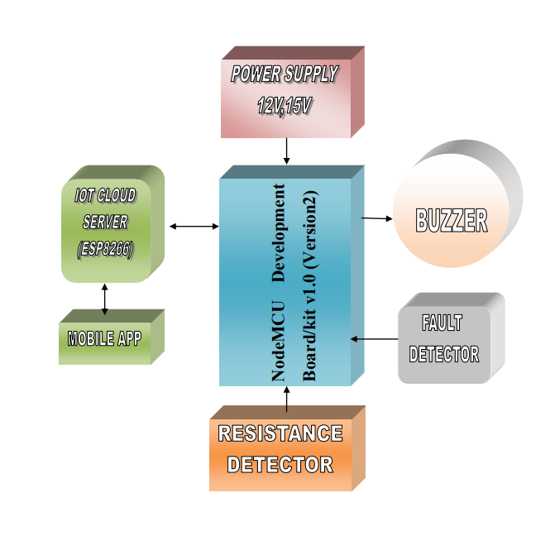
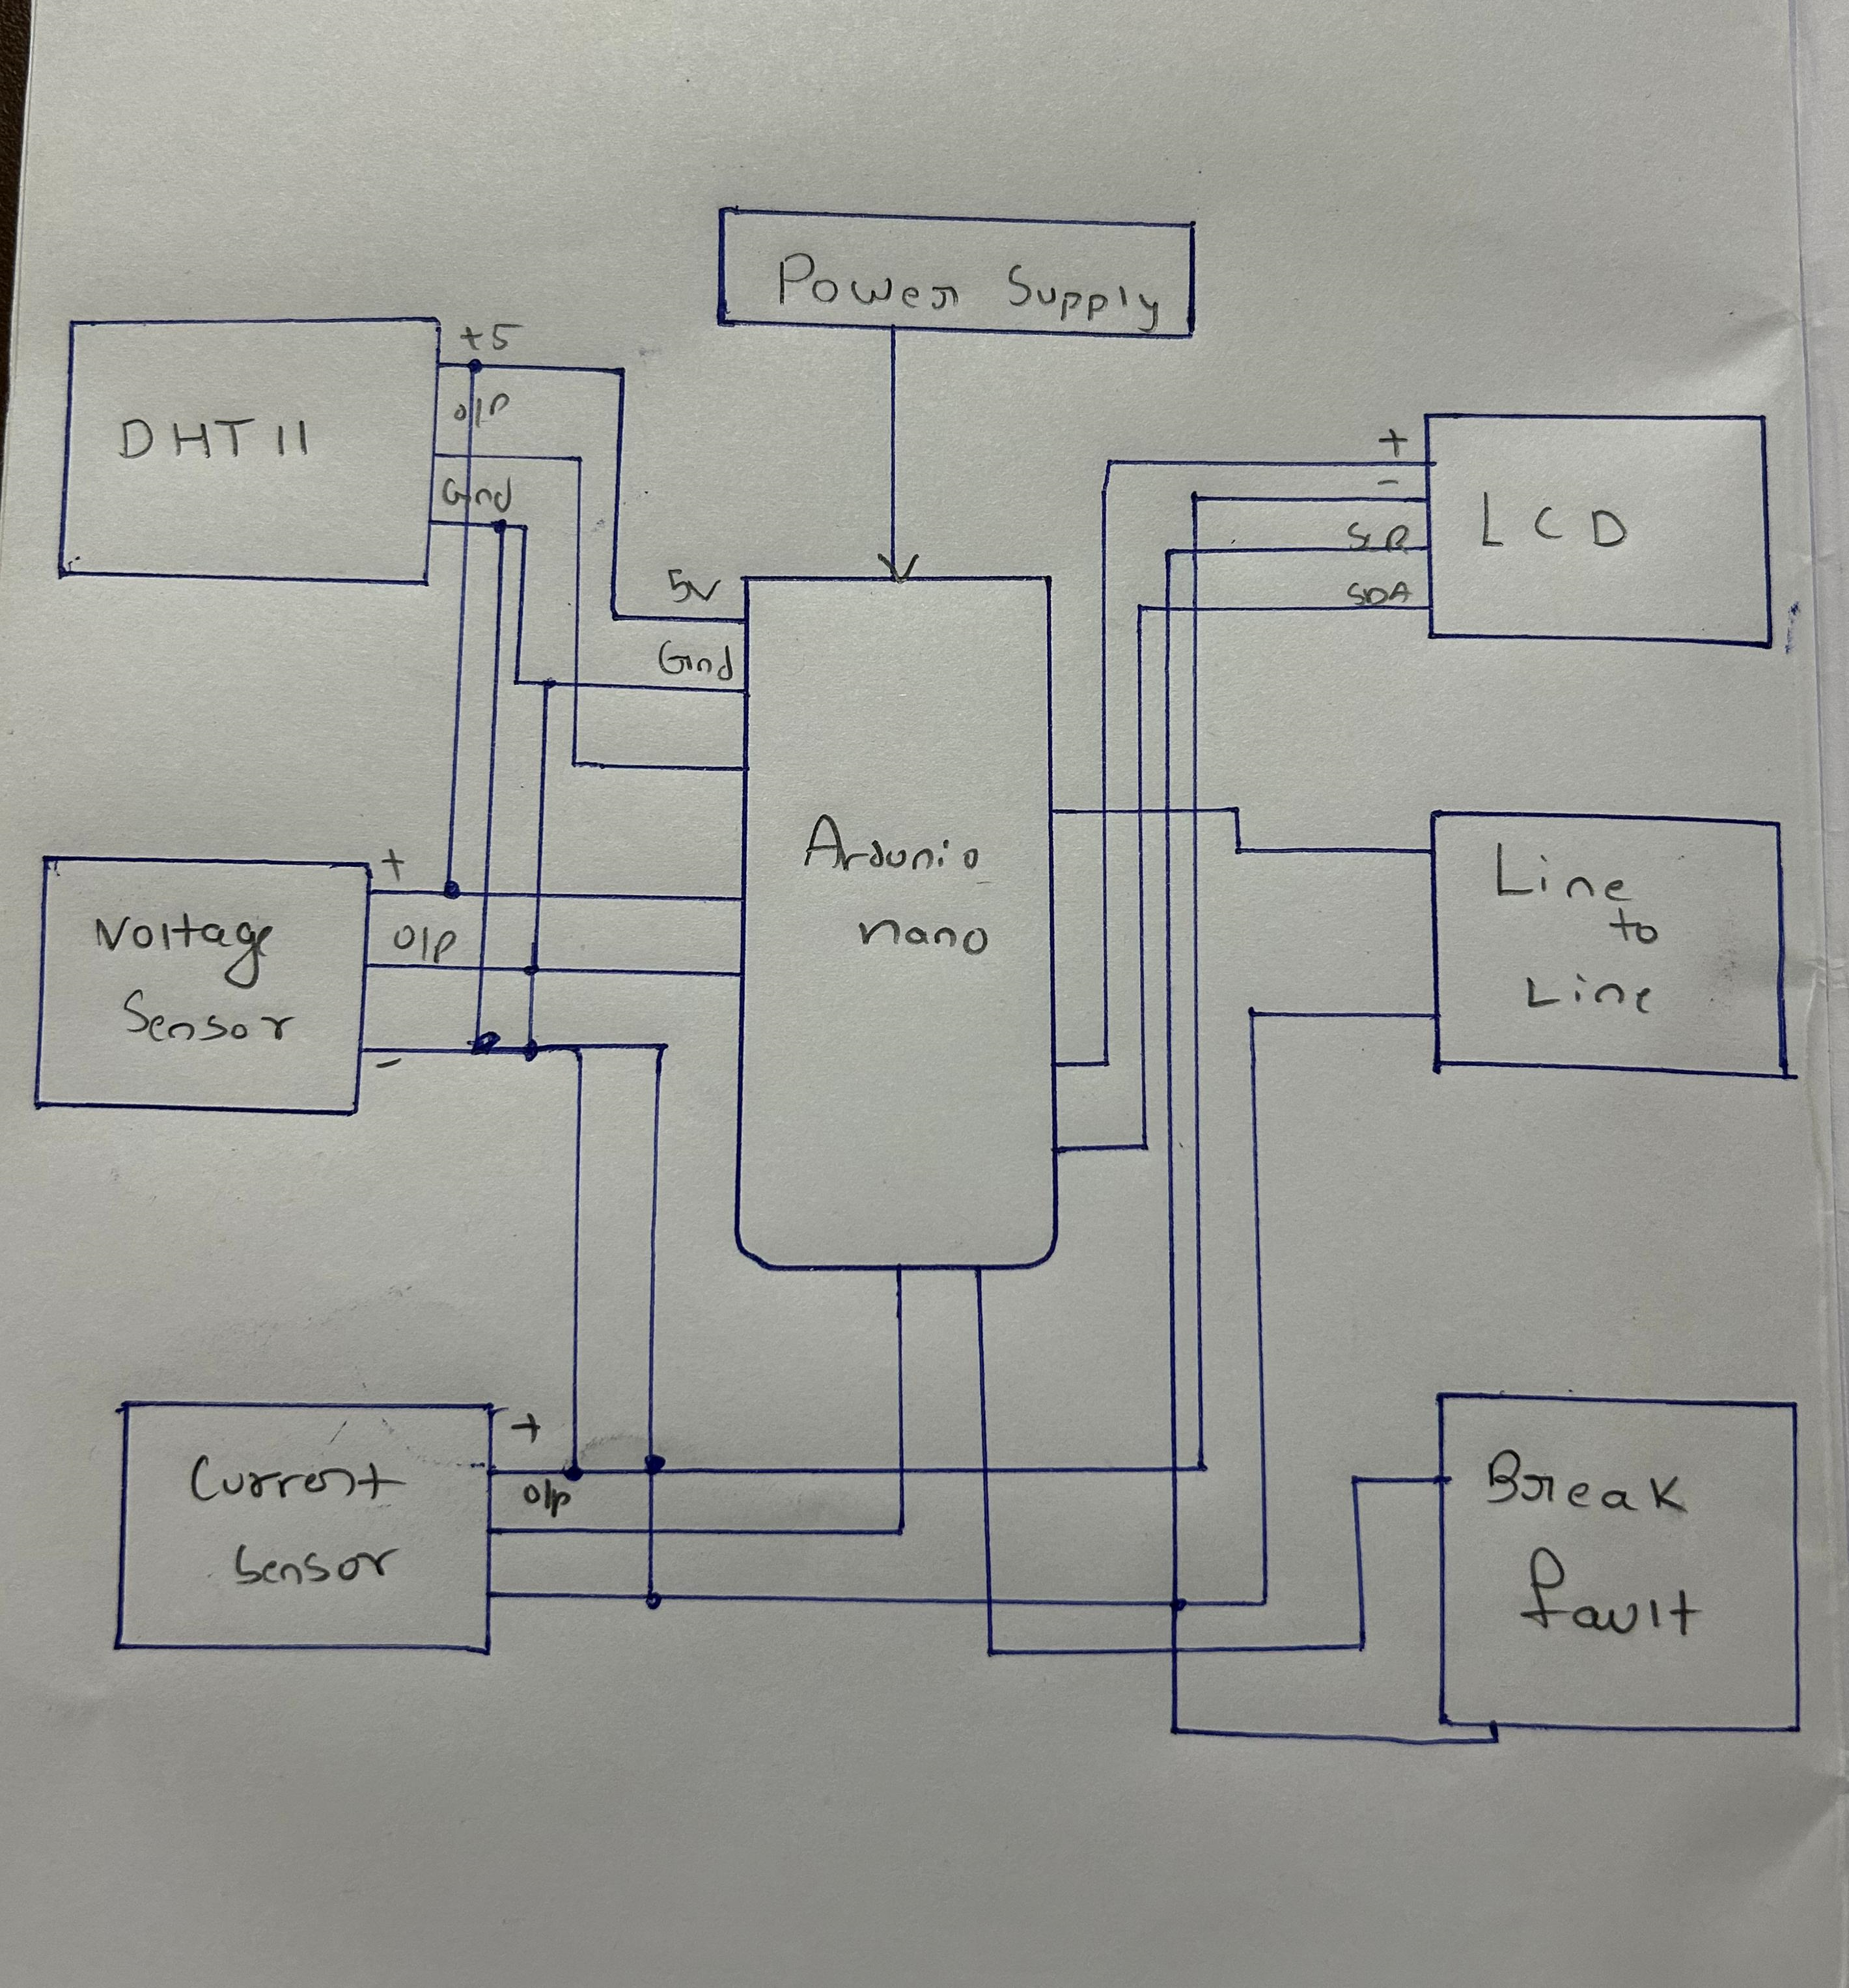
Architecture
Structural Diagram
Block Diagram/Pin Diagram
Behaviour Diagram
Flow chart/ State machine

Slide 6
Use Cases & Testing
Use Cases
1. Utility Companies
Detect and locate faults in underground power cables to minimize downtime and repair time.
Improve operational efficiency by pinpointing faults without excavating large areas.
2. Industrial Plants
Ensure uninterrupted power supply by identifying cable faults in industrial areas.
Enhance safety by preventing risks caused by electrical faults.
3. Urban Infrastructure
Monitor underground cable networks in cities to reduce power outages.
Aid maintenance teams in quick and accurate fault detection.
4. Smart Grids
Integrate fault detection into smart grid systems for automated monitoring and alerting.
Provide real-time fault data to control centers.
5. Educational and Research Purposes
Use the system in laboratories and training institutions for demonstrating fault detection mechanisms.
Test Cases
1. Functional Testing
Test Case 1: Fault Detection
Input: Introduce a short circuit in the cable.
Expected Result: System detects the fault, locates it, and triggers the buzzer.
2: Open Circuit Detection
Input: Disconnect a segment of the cable.
Expected Result: System identifies the open circuit and triggers the buzzer.
Fault Location
Input: Place a fault at a known distance (e.g., 5m) from the test point.
Expected Result: System calculates and displays the correct distance to the fault.
No Fault
Input: Test a healthy cable.
Expected Result: System indicates no fault, and the buzzer remains silent.

Slide 7
COMPONENTS USED:
AURDINO NANO BOARD
LCD DISPLAY
VOLTAGE SENSOR
DTH11 (TEMPERATURE SENSOR)
I2C SERIAL INTERFACE ADOPTER
POWER SUPPLY
RELAY

Slide 8
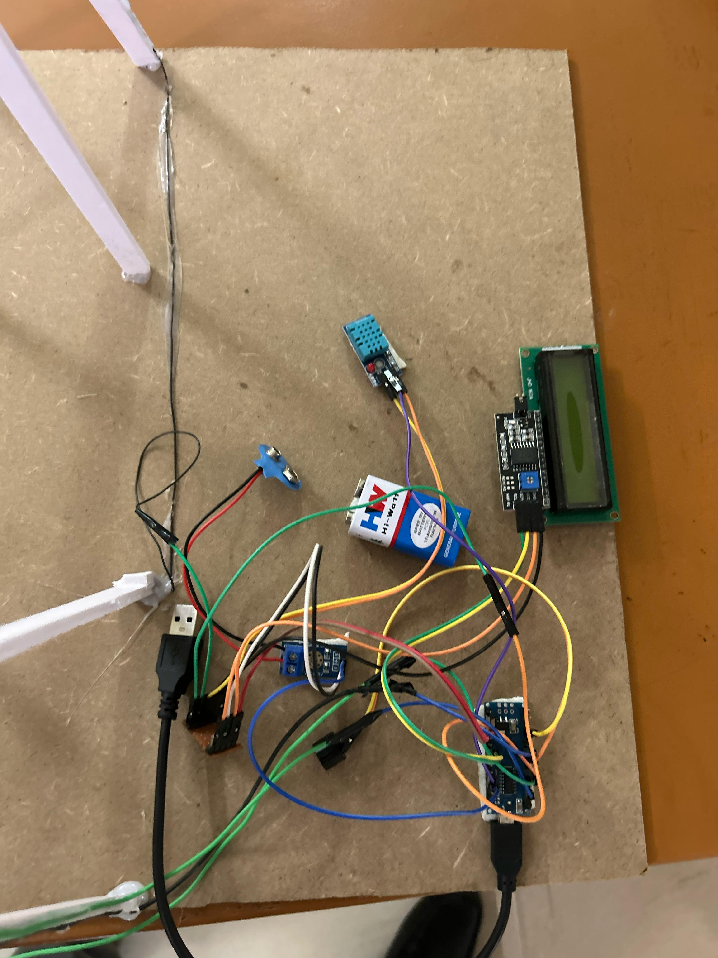
Implementation and Results – Iteration 1
Implementation:
Designed and assembled the basic circuit to monitor
current, voltage, and resistance using sensors.
Integrated a Ardunio nano for data processing and
a buzzer for fault alerts.
Simulated fault conditions (short circuits, open circuits,
ground faults) to test the detection mechanism.
Results:
Successfully detected basic faults and triggered the
alert buzzer.
Limited fault localization accuracy due to minimal calibration.
Observed moderate energy consumption and some delays in fault detection.

Slide 9
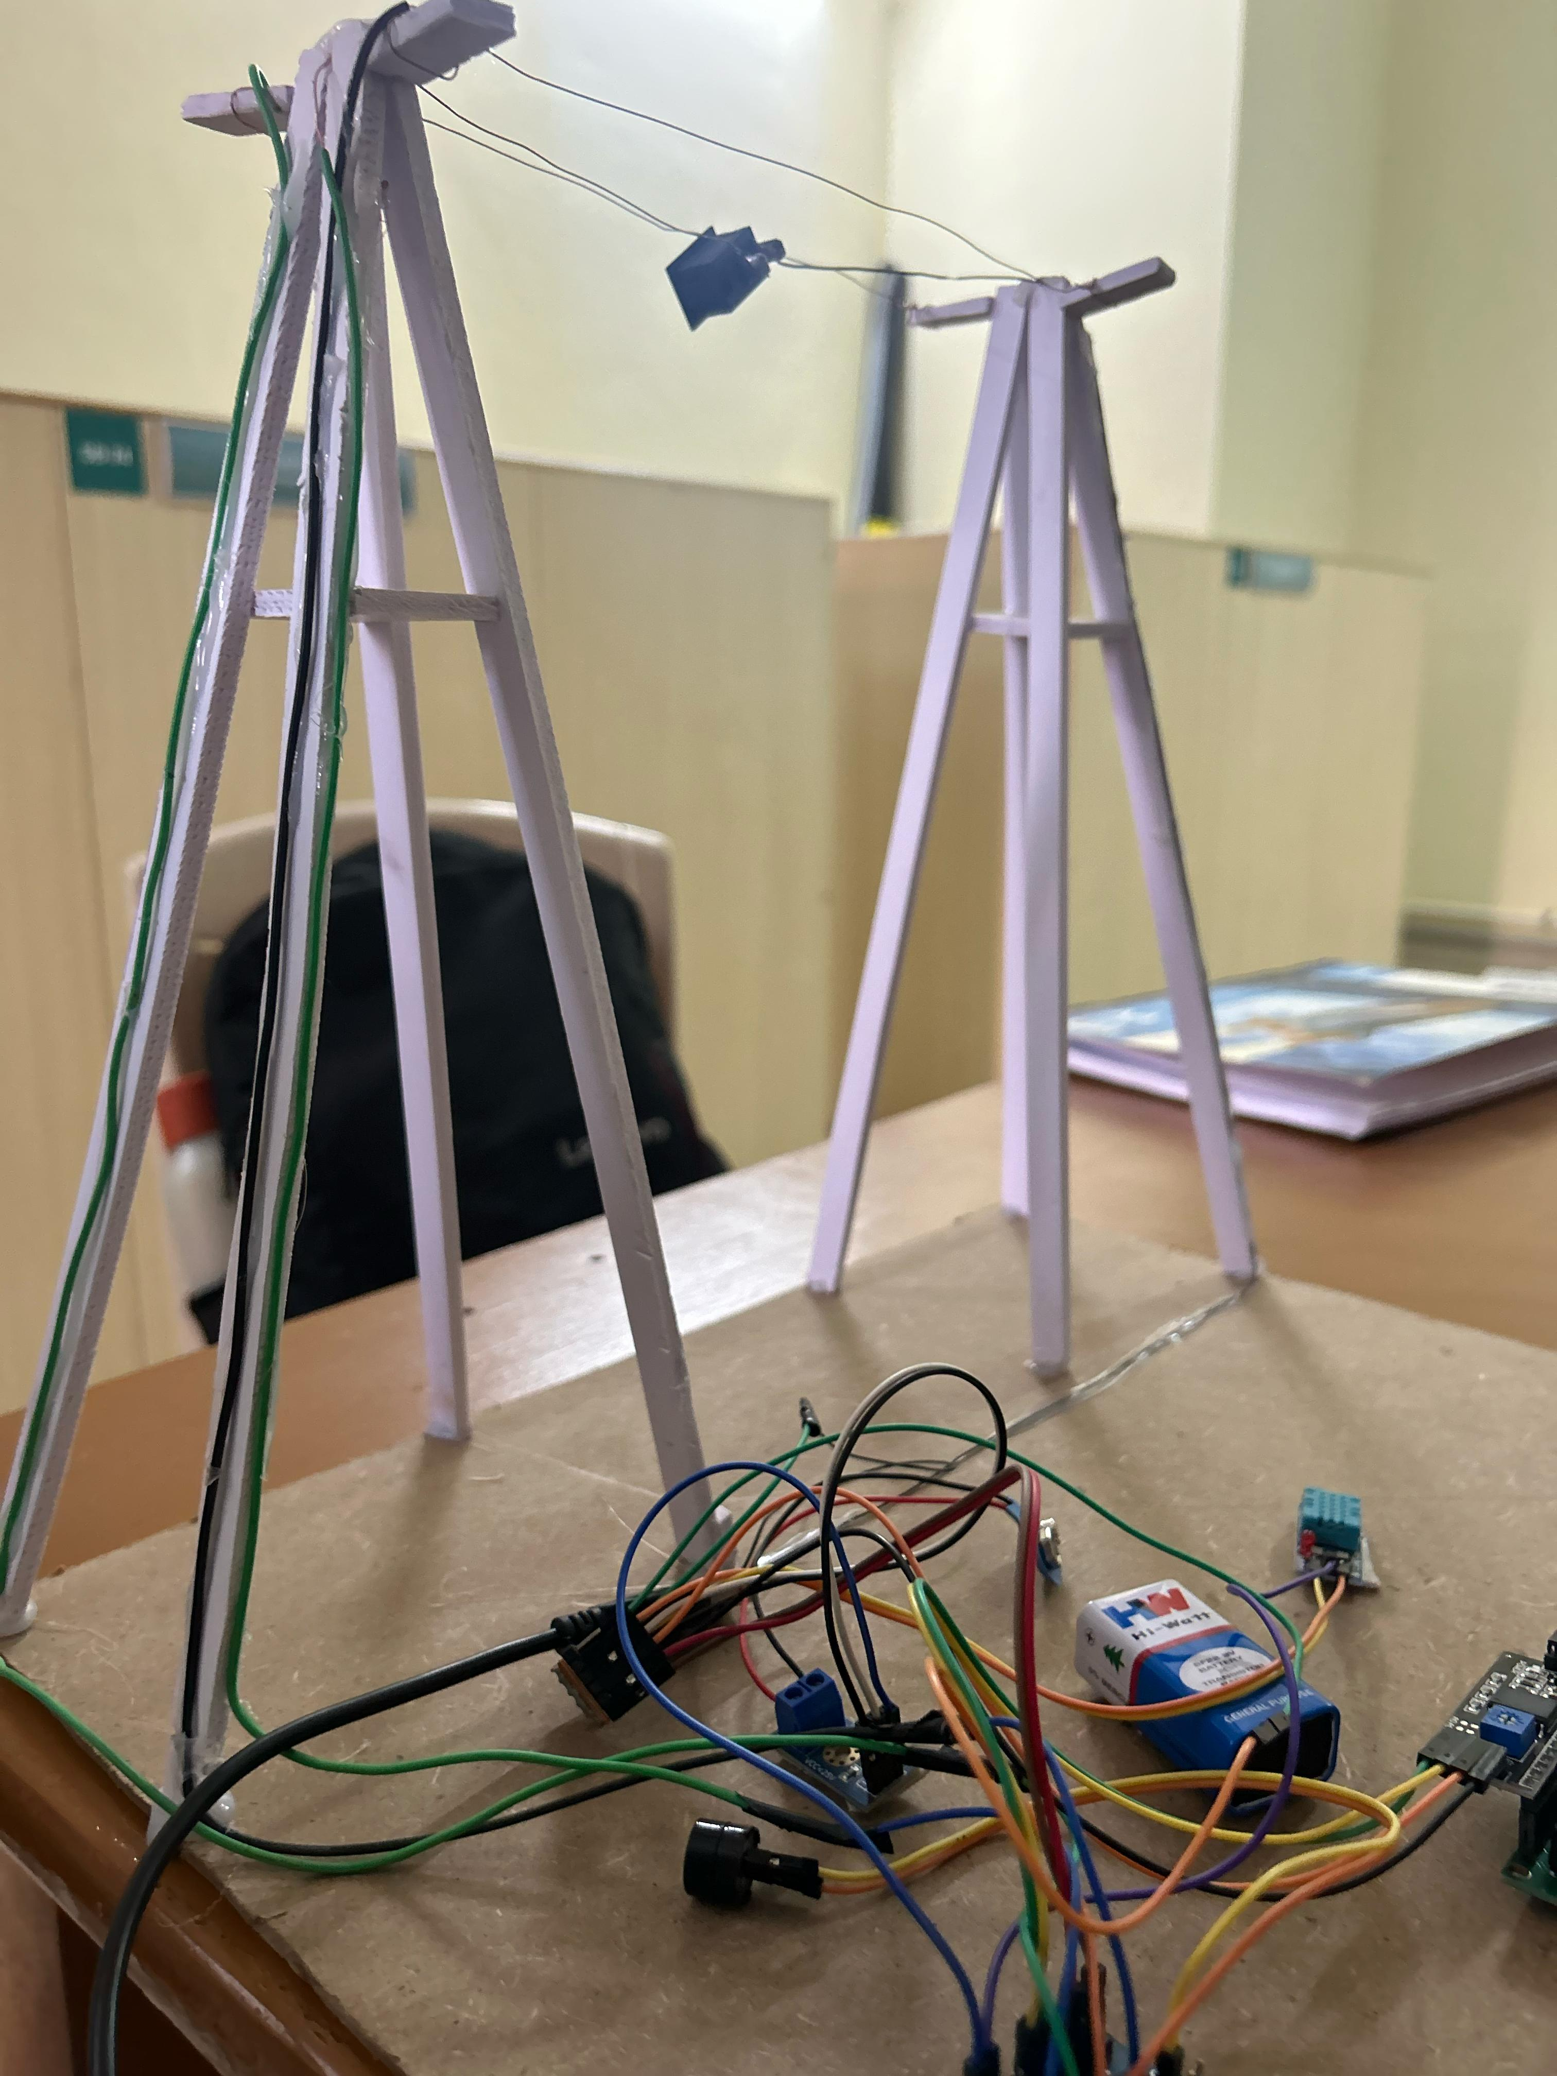
Iteration 2: Enhanced System Design
Implementation:
Improved fault localization by refining sensor placement and calibration.
Optimized the microcontroller’s code for faster processing and reduced power consumption.
Added a visual indicator (e.g., LED display) to show fault location.
Results:
Achieved accurate fault detection and localization within a small margin of error.
Significantly reduced energy usage, improving overall system efficiency.
Real-time fault detection and alerts performed reliably under various test conditions.
System scalability demonstrated by adding additional cable sections for monitoring.

Slide 10
THANK YOU
Have a Great Day !

